Slide 1
Component Models in Java
Dan Trong Thai

Slide 2
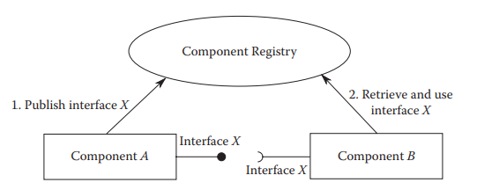
Whiteboard Model

Slide 3
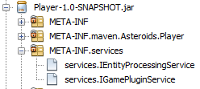
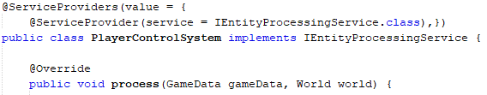
Whiteboard Example
NetBeansLab
Lookup and utility API

Slide 4
Dependency Injection
Inversion of Control
Classes depend on abstraction
Objects define their dependencies without creating them
The Framework creates the object instead

Slide 5
The Spring Framework
Spring Container and Spring Beans
Spring Configuration
Inversion of Control

Slide 6

SpringLab
XML-based configuration
Define Beans
Spring Container
Represented as the ApplicationContext
Multiple instances, each with its own configuration.
Access Beans

